Slide 1
CS 4974 Independent Study
8/25/22 meeting

Slide 2
Questions:
Questions about weekly meeting format
Sharing source code using GitLab
Project submission: Email GitLab tag with project report?

Slide 3
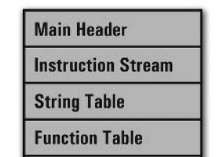
Assembler high-level design idea
A first pass over the source code that processes line label and function entry points.
A second pass over the source that assembles each instruction into its machine code. Also resolving jump labels and function call.
Writing the completed data output to binary file using a structured format that VM recognize.

Slide 4
Goals for this week
Building Framework for assembler
Writing data structure and interfaces for:
Instruction stream
Header
String table
Function table
Symbol table
Label table
Instruction Lookup table
Implementing a simple Lexical analyzer and tokenizer for assembler
Start building test cases

Slide 5
compiler
assembler
script.source
script.assembly
script.executable
Virtual Machine
CPU

Slide 6
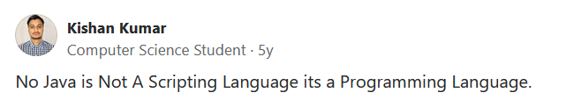
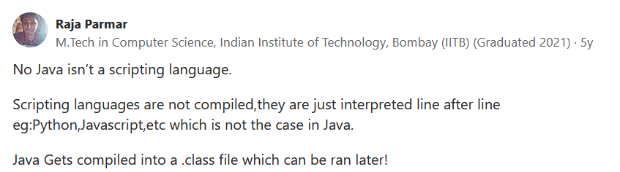
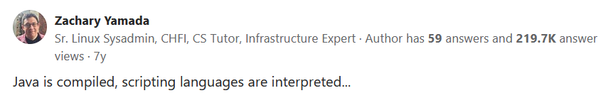
What is consider as scripting language?

